Slide 1
Opioid use disorder is affecting every corner of Arkansas. TOGETHER, WE ARE UNITING TO HELP.
+
togetherarkansas.com

Slide 2
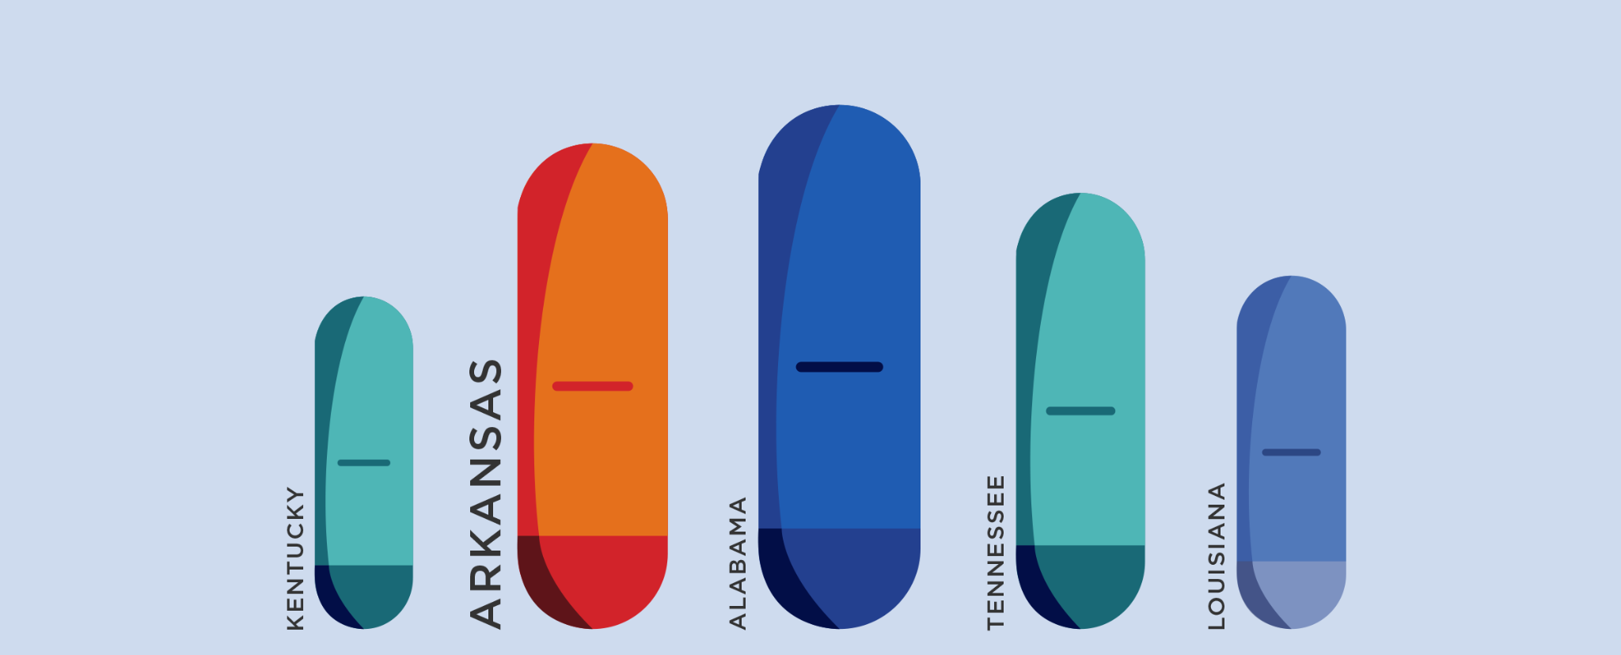
ARKANSAS HAS THE 2ND HIGHEST OPIOID USE RATE IN THE NATION

Slide 3
Opioid use disorder is affecting businesses of every kind — from small operations to large corporations — creating daily challenges for employers and touching the lives of employees and their families.

Slide 4
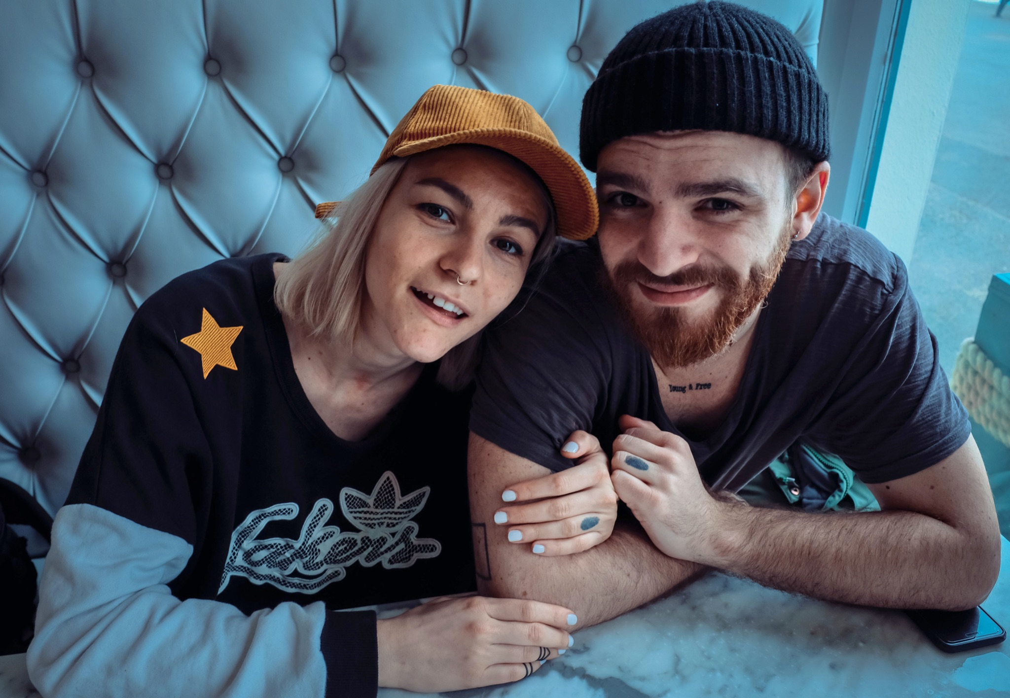
More than ever, employers are challenged to find a ready, drug-free workforce, and to help existing employees who are dealing with drug-related issues of their own, or someone they care about.
THIS CRISIS IS TOO BIG TO GO IT ALONE — it will take all of us.

Slide 5
THE FACTS:
The number of drug overdose deaths increased by nearly 30% from 2019 to 2020 and has quintupled since 1999.
Nearly 75% of the 91,799 drug overdose deaths in 2020 involved an opioid.
187 people die from opioid overdose every day.
Arkansas has the 2nd highest opioid use rate in the nation.

Slide 6
THE SOLUTION
Partnership + Supplying Narcan on site.
As a member of the Together Arkansas coalition, this means we have Narcan on site and available to you, if you need it.

Slide 7
WHAT IS NARCAN?
Narcan (Naloxone) is an FDA approved medication designed to rapidly reverse opioid overdose.

Slide 8
Under current Arkansas law, Narcan is available to anyone with concern about opioid overdose. Contact your pharmacist for more information about Narcan dispensers.

Slide 9
Q. HOW DO I ADMINISTER NARCAN?
A. PEEL back the package to remove the device. Hold the device with your thumb
on the bottom of the plunger and two fingers on the nozzle.
PLACE and hold the tip of the nozzle in either nostril until your fingers touch the bottom of the patient’s nose.
PRESS the plunger firmly to release the dose into the patient’s nose.

Slide 10
Q. CAN I GET IN TROUBLE IF I COME TO YOU FOR HELP?
A. Arkansas is 1 of the 40 states exercising the Joshua Ashley-Pauley Act “Good Samaritan” law, which encourages people to seek out medical attention for an overdosing person and for follow-up medical care after Narcan (naloxone) has been administered.
These laws provide immunity from arrest, charge or prosecution for certain controlled substance possession and paraphernalia offenses when a person who is either observing or experiencing an opiate-related overdose calls 911 for assistance or seeks medical attention.

Slide 11
1-800-662-HELP (4357)
The National Drug Addiction Helpline
1-844-763-0198
The Arkansas Mental Health & Addiction Support Line

Slide 12
Opioid use disorder is affecting every corner of Arkansas.
TOGETHER, WE ARE UNITING TO HELP.
+
togetherarkansas.com

